Slide 1
Developing an ER Diagram
Module 9
Prepared by: Engr. Ryan D. Francisco

Slide 2
4. 2 Developing an ER Diagram
Database design is an iterative process
Create detailed narrative of organization’s description of operations
Identify business rules based on description of operations
Identify main entities and relationships from business rules
Develop initial ERD
Identify attributes and primary keys that adequately describe entities
Revise and review ERD

Slide 3
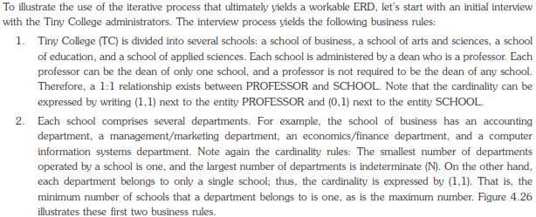

Slide 4
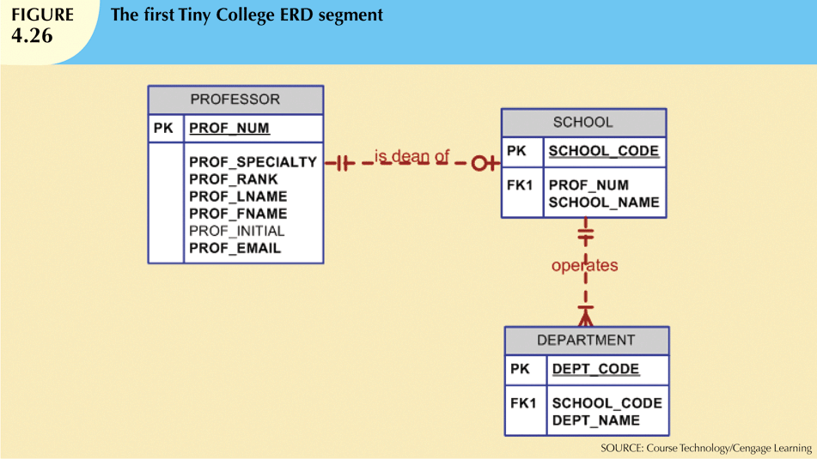

Slide 5
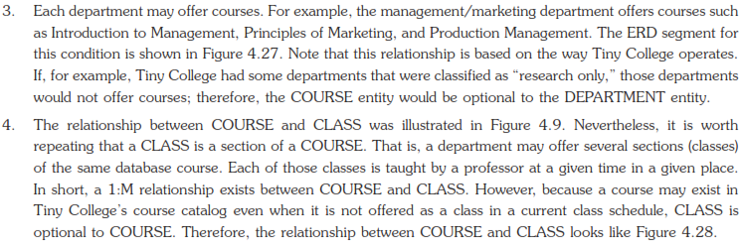
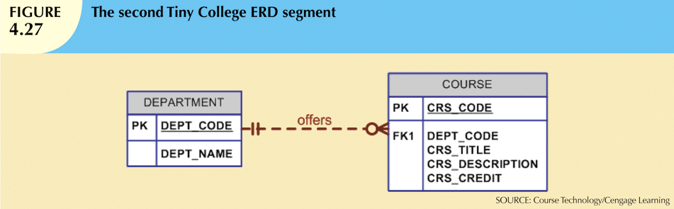

Slide 6
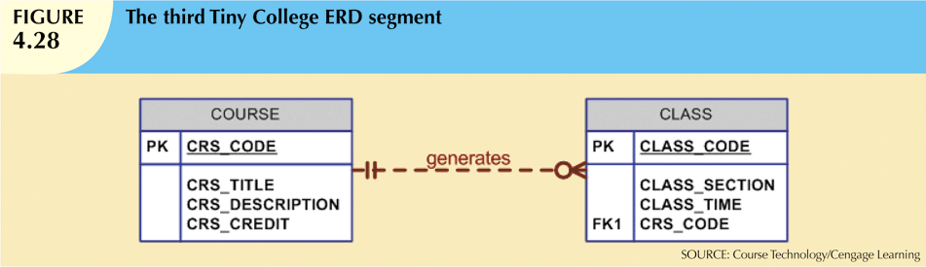

Slide 7
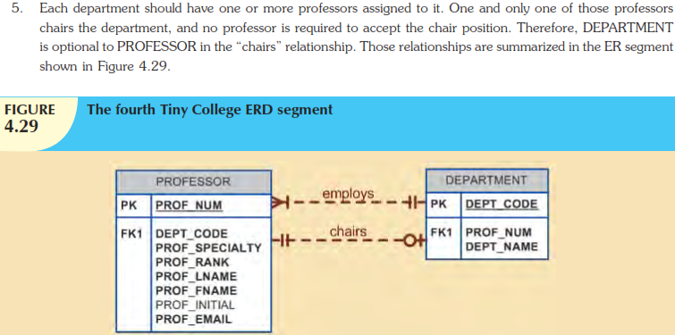

Slide 8
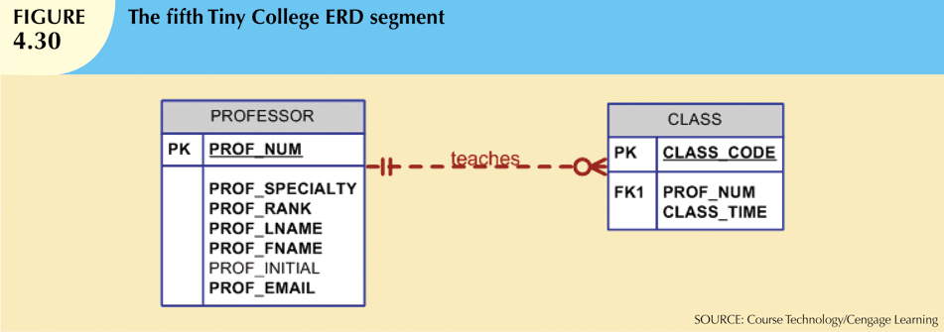

Slide 9
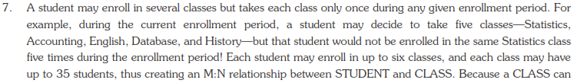
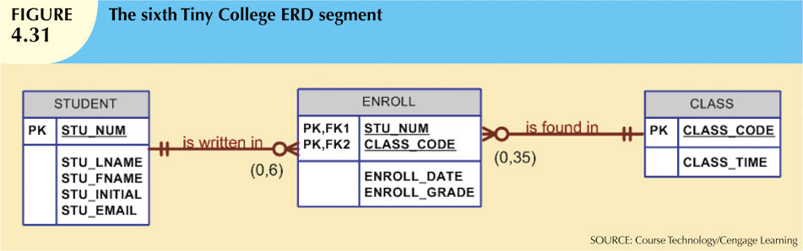
initially exist (at the start of the enrollment period) even though no students have enrolled in it, STUDENT is optional to CLASS in the M:N relationship. This M:N relationship must be divided into two 1:M relationships through the use of the ENROLL entity, shown in the ERD segment in Figure 4.31.

Slide 10
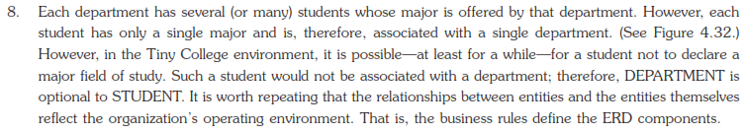
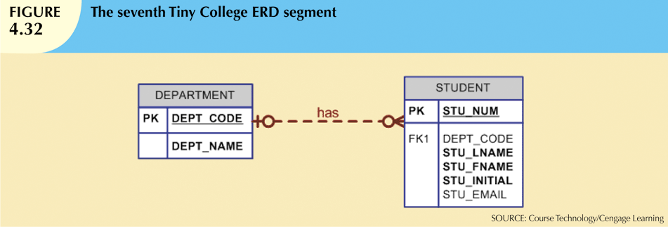

Slide 11
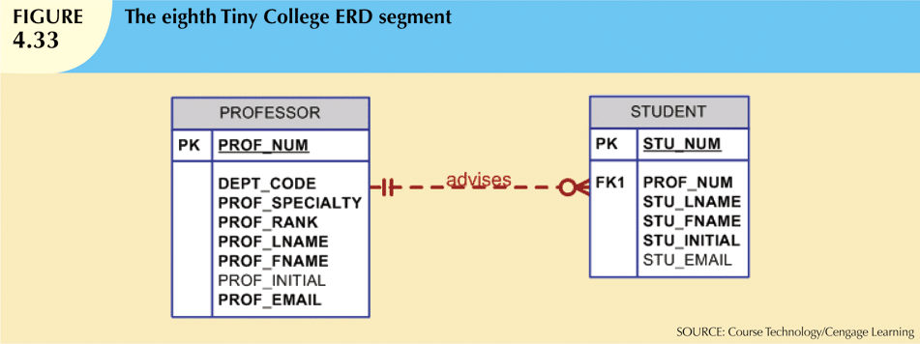

Slide 12

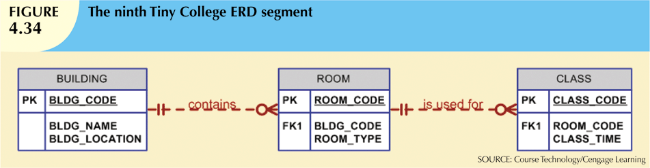

Slide 13
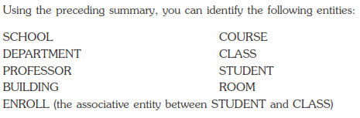

Slide 14
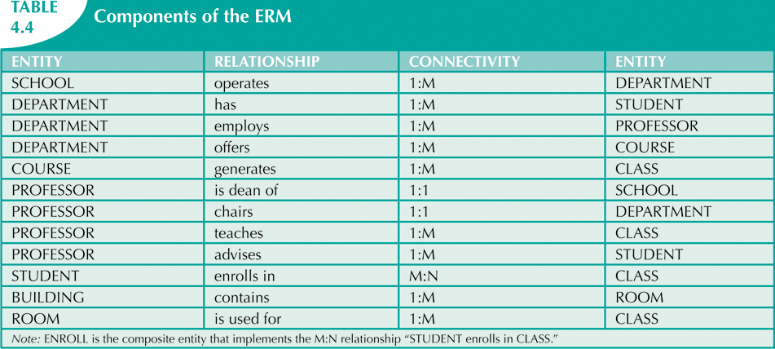

Slide 15
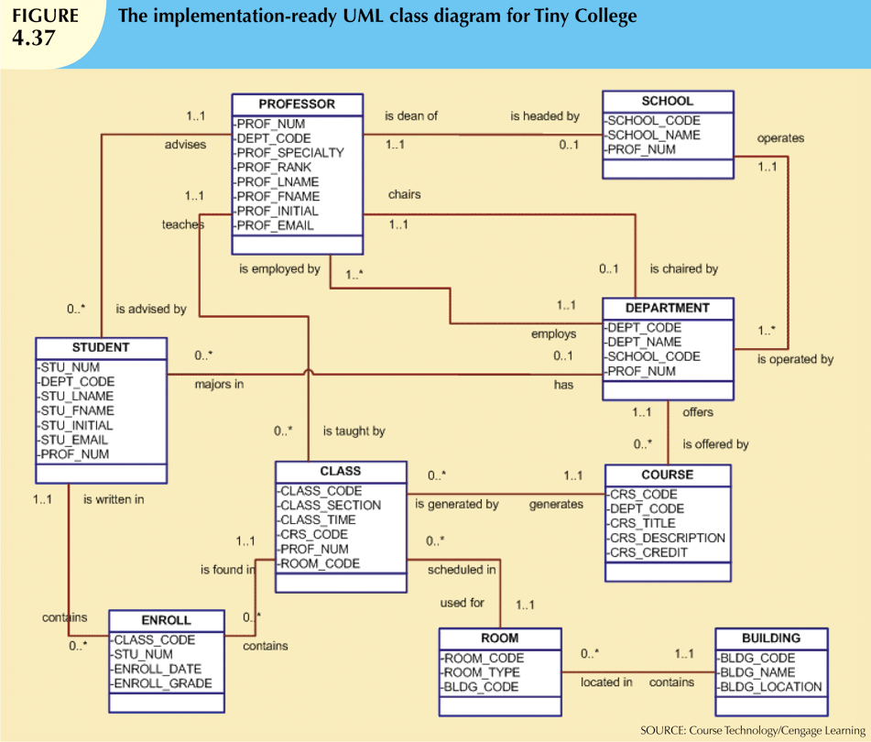
Figure 4.37 shows the implementation-ready UML class diagram for Tiny College (note that the ENROLL composite entity is shown in this class diagram.

